Slide 1



USA Flights Performance DWH
Hanna Klimovich
December 2, 2017

Slide 2


USA Flights Performance dwh
DWH will provide research department of the all American airports and companies schedule with flight performance information (departures, arrivals, etc.).

Slide 3

Which problems solves?
Frequently flights may be delayed.
Passengers seemed to be disappointed and even angry about that.
That is the reason why they can prefer one company on another.
Today it’s hard to know and analyze data about flight performance.
With the help of our DWH flight performance may be analyzed to improve your company status by static time schedule.

Slide 4
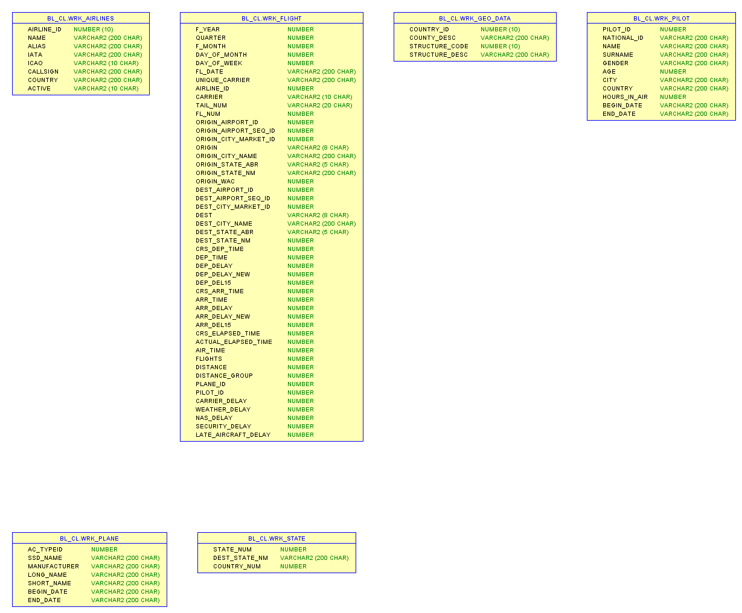
Source tables
Almost all data is real (except pilots personal information)
Begin date and end date generated in sources
Locations are in separate tables

Slide 5
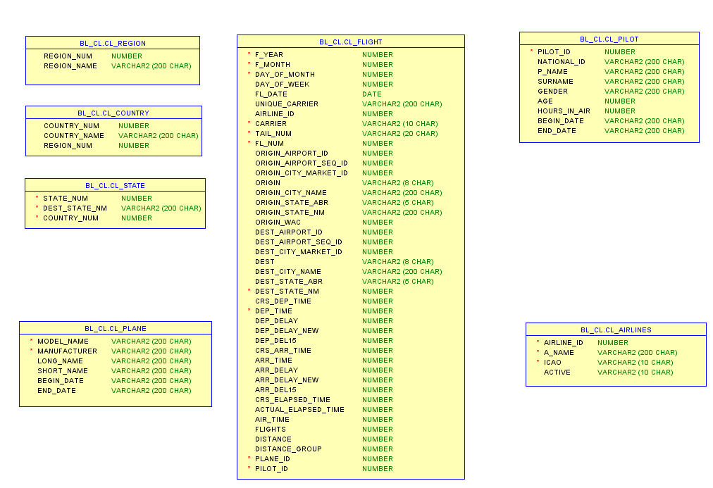
Cleansing tables
Fl_date in fact table converted to DATE type
Locations split by regions, countries and states (cities will be loaded in the nearest future ☺)
Tables were cleaned here

Slide 6
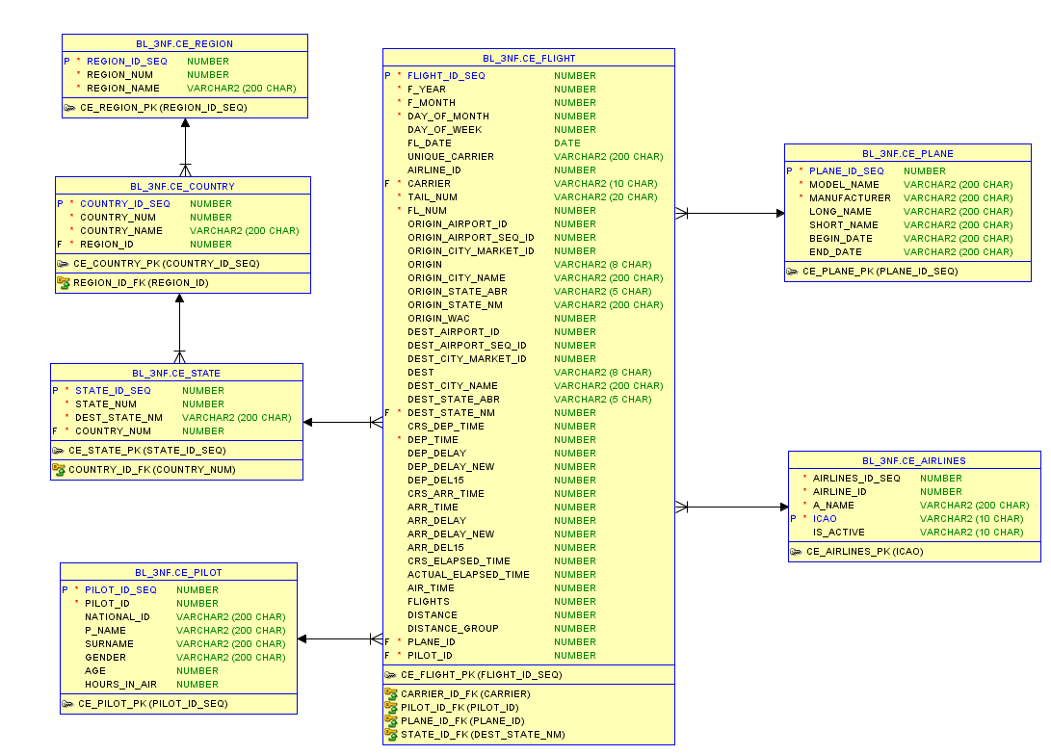
3NF tables
Added PK as a sequences in all tables
Managed all FK constraints in fact table and location tables
All tables references by generated id columns

Slide 7
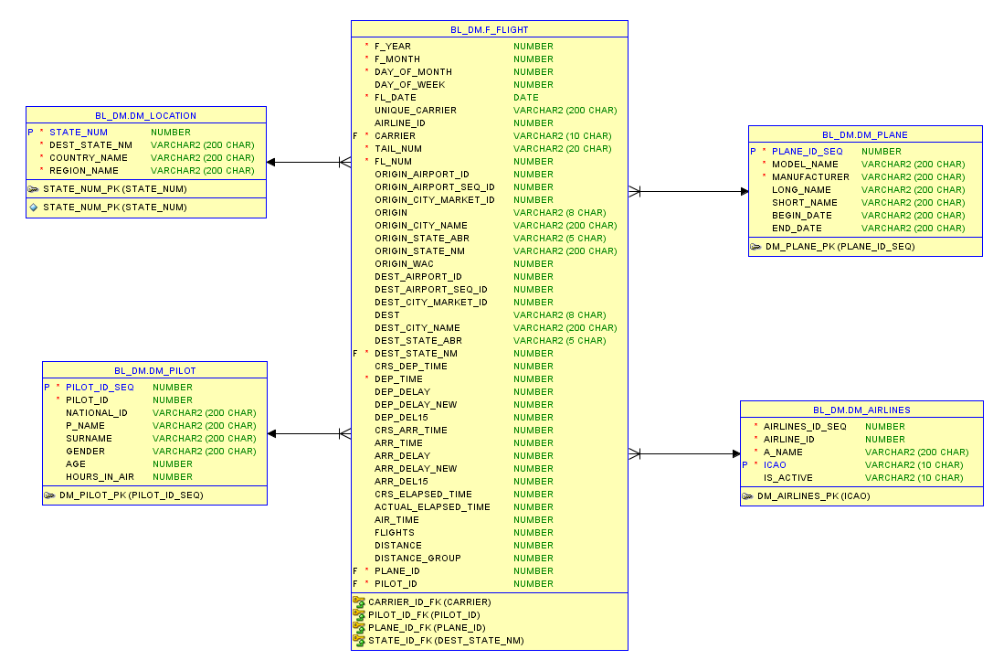
Dimensional tables
All geodata stored in dimension location
Lots of parameters to analyze in fact table
Ready to use

Slide 8

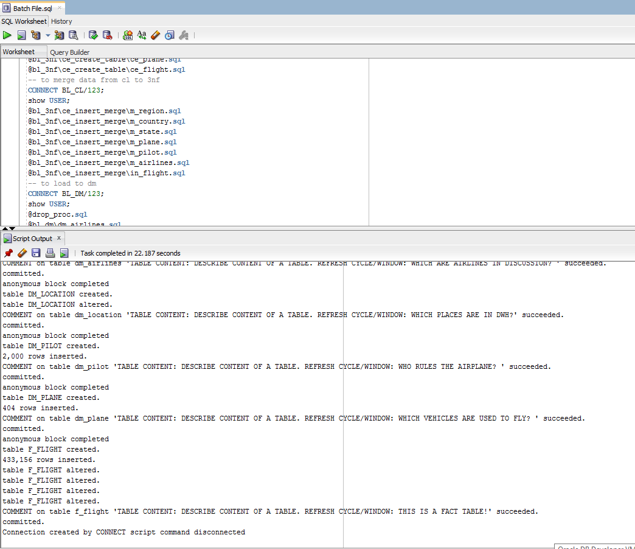
All you need is BATCH
You simply need to run batch file

Slide 9
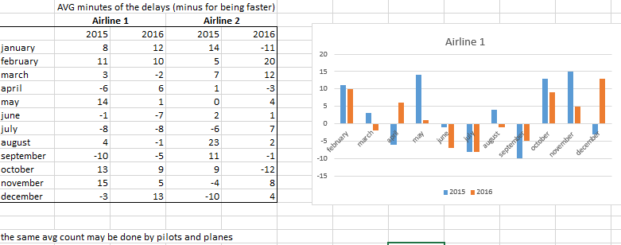
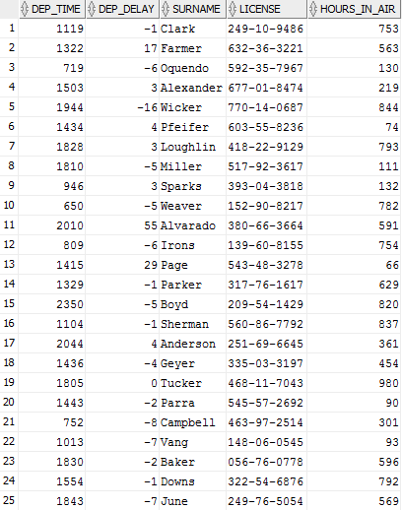
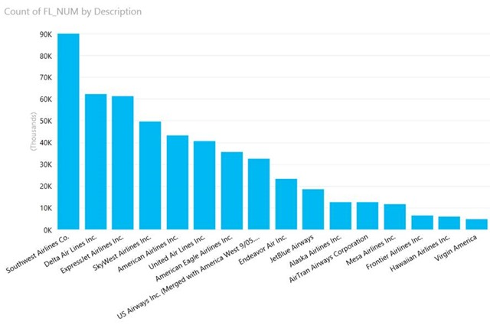
Examples of reports

Slide 10
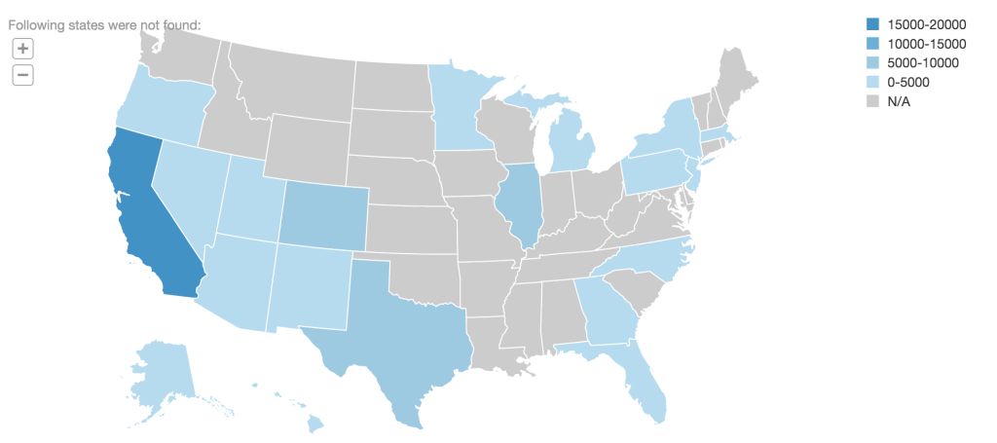
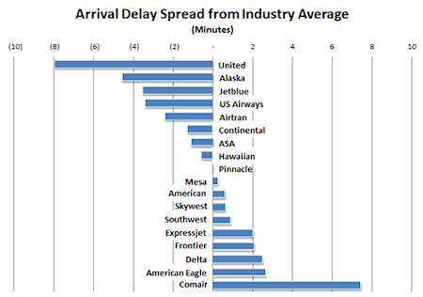
Examples of reports

Slide 11
5 reasons to buy DWH
1
All American airlines flights performance stored together
2
Database of all pilots
3
Database of all planes
4
Variety of possible reports by pilots, places and planes
5
Easy to interact with the help of batch file

Slide 12

Choose us to win service awards

Slide 13

If you have any questions
You are welcome
To ask
Hanna Klimovich

